Slide 1

Ecommerce Purchase Prediction
Presented by Jeremy Alekai Stewart

Slide 2
Introduction
Client is a retail company that wants to increase their sales revenue by targeting customers who are more likely to make a purchase.
Problem Statement:
Identify which customers are more likely to make a purchase based on their demographic and past purchase behavior.

Slide 3
A brief introduction to the dataset used
Overview:
We collected data on 10,000 customers, including their age, gender, income, education level, and past purchase behavior.
Target:
Our target variable is a binary indicator of whether or not the customer made a purchase during their most recent visit to the store.

Slide 4
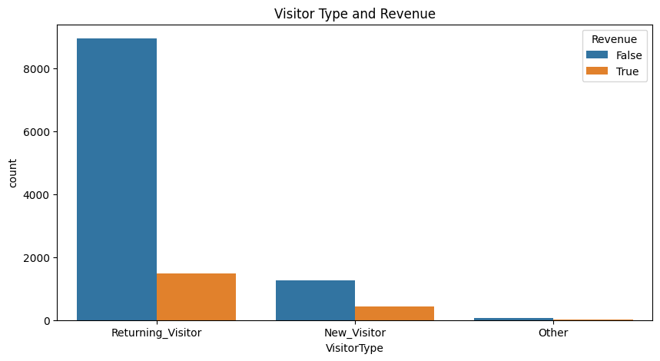
Visual 1 - Relationship Between Website Visitors and Revenue
Findings:
Returning visitors are more likely to make a purchase and they return because of quality goods and services..
Insight:
Emphasis on in-app advertisement because returning visitors are the one that are most likely to make a purchase
03

Slide 5
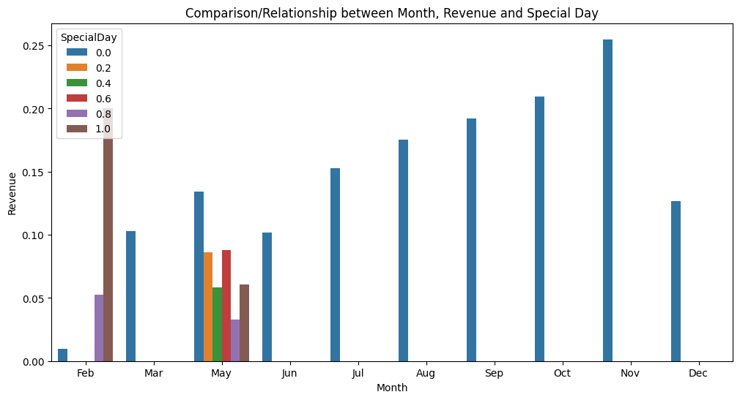
Visual 2 - Relationship Between Month, Revenue and Special/Public Holidays
Findings:
Certain months, such as November and October, appear to have higher sales than other months.
Visitors who visit the website on special days are more likely to make a purchase.
Insight:
Timing marketing and promotions around high-sales months could drive sales.
Creating targeted campaigns and promotions around special days could lead to increased sales
03

Slide 6
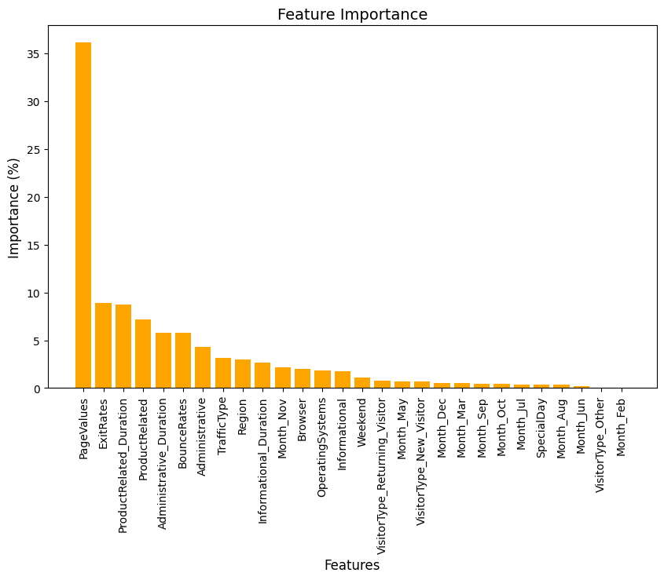
Visual 2 - Feature Importance
Findings:
It helps to identify which variables or features are most important in predicting the target variable.
Insight:
03

Slide 7
Strengths and limitations
Strengths:
The model correctly predicts the outcome 90% of the time. (High Accuracy= 0.90)
The precision score of 0.93 for the False class suggests that when the model predicted the outcome to be False, it was accurate 93% of the time.
The recall score of 0.95 for the False class indicates that the model correctly identified 95% of all the actual False cases.
Limitations:
The precision score of 0.68 for the True class suggests that when the model predicted the outcome to be True, it was accurate only 68% of the time.
The recall score of 0.56 for the True class indicates that the model correctly identified only 56% of all the actual True cases.
The F1-score of 0.61 for the True class shows that the model is not performing well in predicting the True class, which means it is not very effective in identifying the actual positive cases.
Notes:
Strengths:
The model correctly predicts the outcome 90% of the time. (High Accuracy= 0.90)
The precision score of 0.93 for the False class suggests that when the model predicted the outcome to be False, it was accurate 93% of the time.
The recall score of 0.95 for the False class indicates that the model correctly identified 95% of all the actual False cases.

Slide 8
Recommendations
Emphasis on in-app advertisement because returning visitors are the one that are most likely to make a purchase.
Timing marketing and promotions around high-sales months could drive sales.
Creating targeted campaigns and promotions around special days could lead to increased sales

